Slide 1

Learning Through Art:
SPHE
Resouce Pack
Sinéad Hall

Slide 2
Introduction
Learning through art is at the heart of the National Gallery of Ireland’s primary school programme. Art helps us to understand the world and can be used in the classroom to engage with themes and subjects across the curriculum. Our series of Learning Through Art resources are designed as practical toolkits to enable you to use artworks as primary sources and inspiration for lessons in other core curriculum areas.
Contents
How to use this resource ……………………………..…… 3
Learning Objectives …………………….......................... 4
The Workshop ………………………………………….………. 5
Additional Activities ……………….………………….……. 25
Resources …………………........................................... 26
Worksheets ………………………………………..…….……. 27
Contact us …………... ……......................................... 35
About the author
Sinéad Hall BA, PGD ED, CRS, MA ED is a classically- trained pianist, and passionate educator with nearly two decades of experience teaching in Irish and American classrooms. Sinéad has earned degrees in Music, Human Development, Gaeilge, a Postgrad in Education, and a Masters in Leadership and Management. She teaches 5th class in Ratoath SNS, is a Visual Arts tutor and a research supervisor for the Primary Masters of Education with Hibernia College. Her passions include playing the piano, art, watersports, her two children, her Schnauzer dogs, good coffee and music. Sinéad is active in the community and in her free time can be found scouting, teaching in her art club
and surfing.

Slide 3
How to use this resource
This is part of a series of practical guides to teaching different curriculum areas through art.
Each resource provides you with:
A PowerPoint slide show for you and your class to read through
Images of a key artwork from the Gallery’s collection
Information about the painting and the artist
Looking and responding questions to ask your class
Discussion points
Curriculum-linked lessons based on the work
Worksheets to print out and use along with the lessons
A resource list of additional websites that you can use for further research and reading
Additional lesson ideas for other subjects

Slide 4
Learning Objectives
The child should be enabled to:
look at and talk about the work of artists
describe what is happening in the painting;
  the colours and tones chosen
  the lines, shapes, textures and pattern created
  how they are arranged in the painting
  how colour was used and effects created
  what he/she or the artist was trying to express
  what he/she likes best about the painting
respond to the work of artists through designed lessons

Slide 5
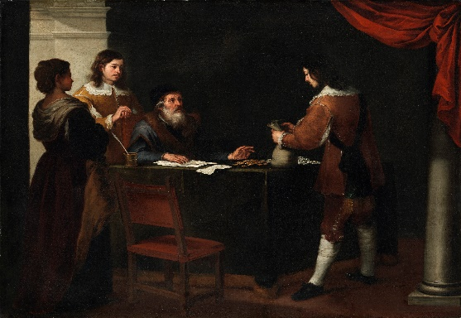
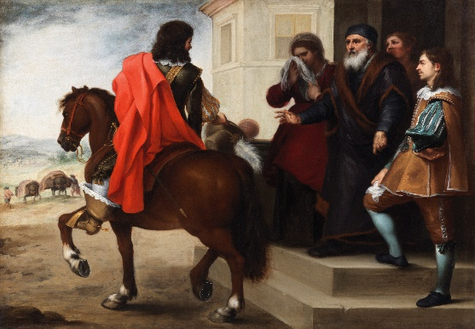
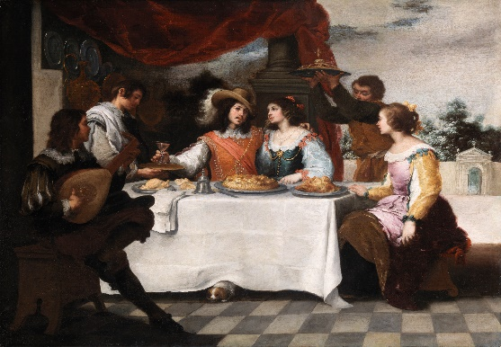
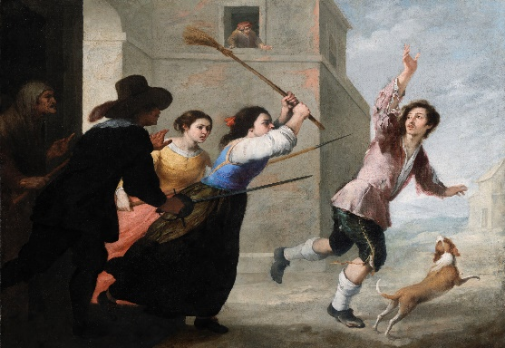
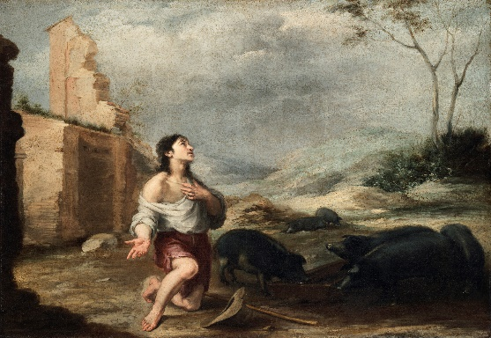
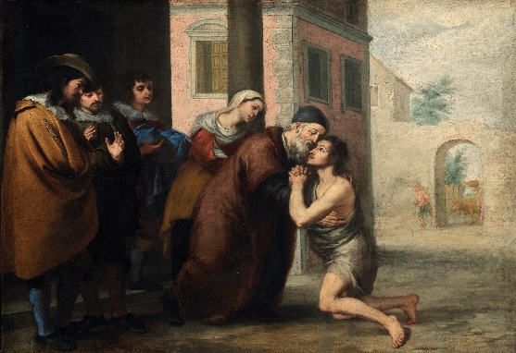

The Workshop
Also available as an adaptable PowerPoint slideshow

Slide 6
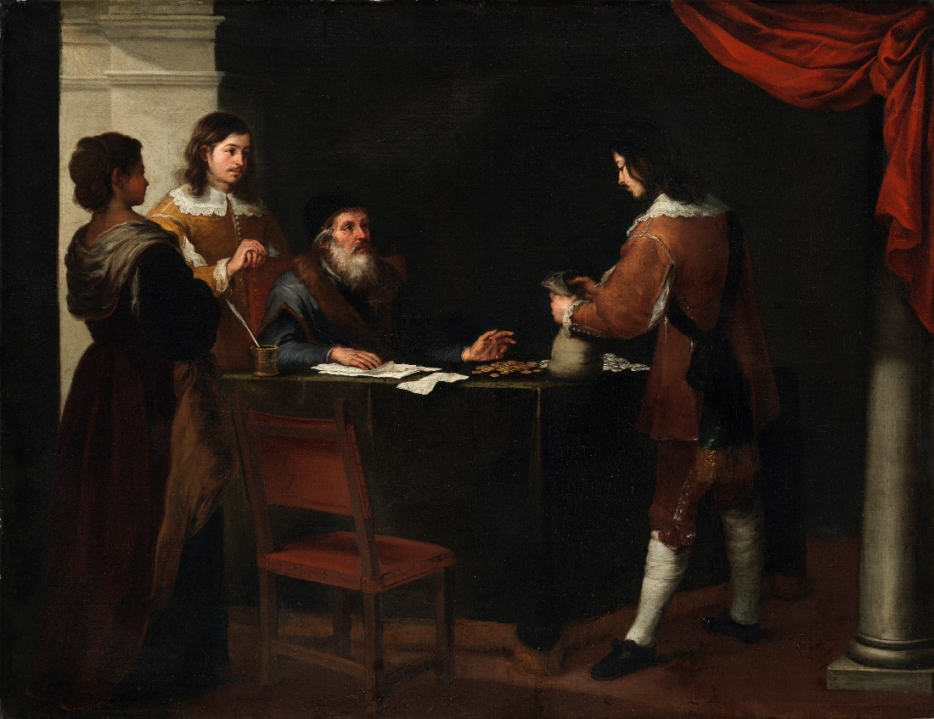
The Prodigal Son Receiving his Portion, 1660s
Bartolomé Esteban Murillo (1617-1682)
Presented, Sir Alfred and Lady Beit, 1987 (Beit Collection). Photo © National Gallery of Ireland.

Slide 7

The Departure of the Prodigal Son, 1660s
Bartolomé Esteban Murillo (1617-1682)
Presented, Sir Alfred and Lady Beit, 1987 (Beit Collection). Photo © National Gallery of Ireland.

Slide 8

The Prodigal Son Feasting, 1660s
Bartolomé Esteban Murillo (1617-1682)
Presented, Sir Alfred and Lady Beit, 1987 (Beit Collection). Photo © National Gallery of Ireland.

Slide 9

The Prodigal Son Driven Out, 1660s
Bartolomé Esteban Murillo (1617-1682)
Presented, Sir Alfred and Lady Beit, 1987 (Beit Collection). Photo © National Gallery of Ireland.

Slide 10

The Prodigal Son Feeding Swine, 1660s
Bartolomé Esteban Murillo (1617-1682)
Presented, Sir Alfred and Lady Beit, 1987 (Beit Collection). Photo © National Gallery of Ireland.

Slide 11

The Return of the Prodigal Son, 1660s
Bartolomé Esteban Murillo (1617-1682)
Presented, Sir Alfred and Lady Beit, 1987 (Beit Collection). Photo © National Gallery of Ireland.

Slide 12



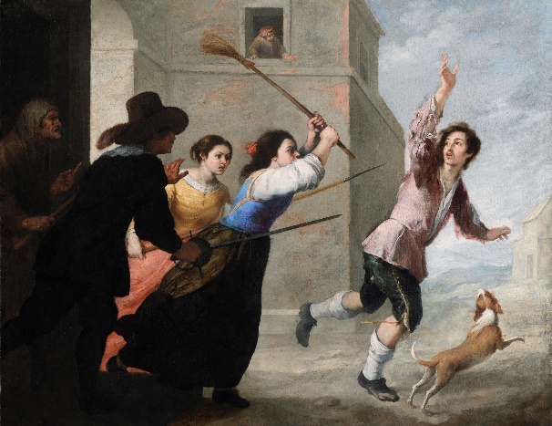
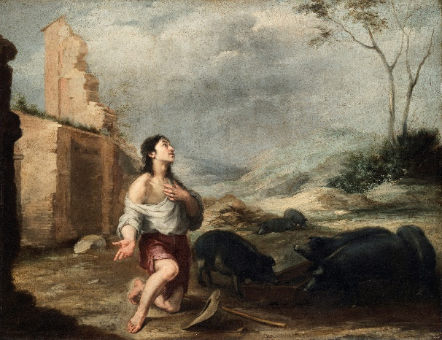


Slide 13
We can learn a lot about SPHE from paintings
Here we have six paintings by the famous Spanish painter Bartolomé Esteban Murillo. For decades, these paintings were separated and some even lost, but now the Gallery has found them all and brought them back together. Conservators in the Gallery have spent many years restoring and cleaning them.
These six remarkable paintings tell the story of the Prodigal Son. The works are known as a ‘narrative cycle’ - a series of paintings that go together to make a story over several canvases, like an elaborate comic strip.
Do you know they story of the Prodigal Son?
Could you tell the story from looking at Murillo’s comic strip of paintings?

Slide 14
The Story
There was once a man who had two sons. One day, the youngest son asked his father for his inheritance money - this is money or property passed on to a child after the death of a parent. The father thought about it and divided what he owned between them, giving his sons their inheritance.

Slide 15
The Story
The youngest son decided that he wanted to have a more exciting life. He put on his finest clothes, took the best horse and moved far away from home. His mother was upset that he was leaving but he was excited to see the world. The elder brother decided to stay with his parents.

Slide 16
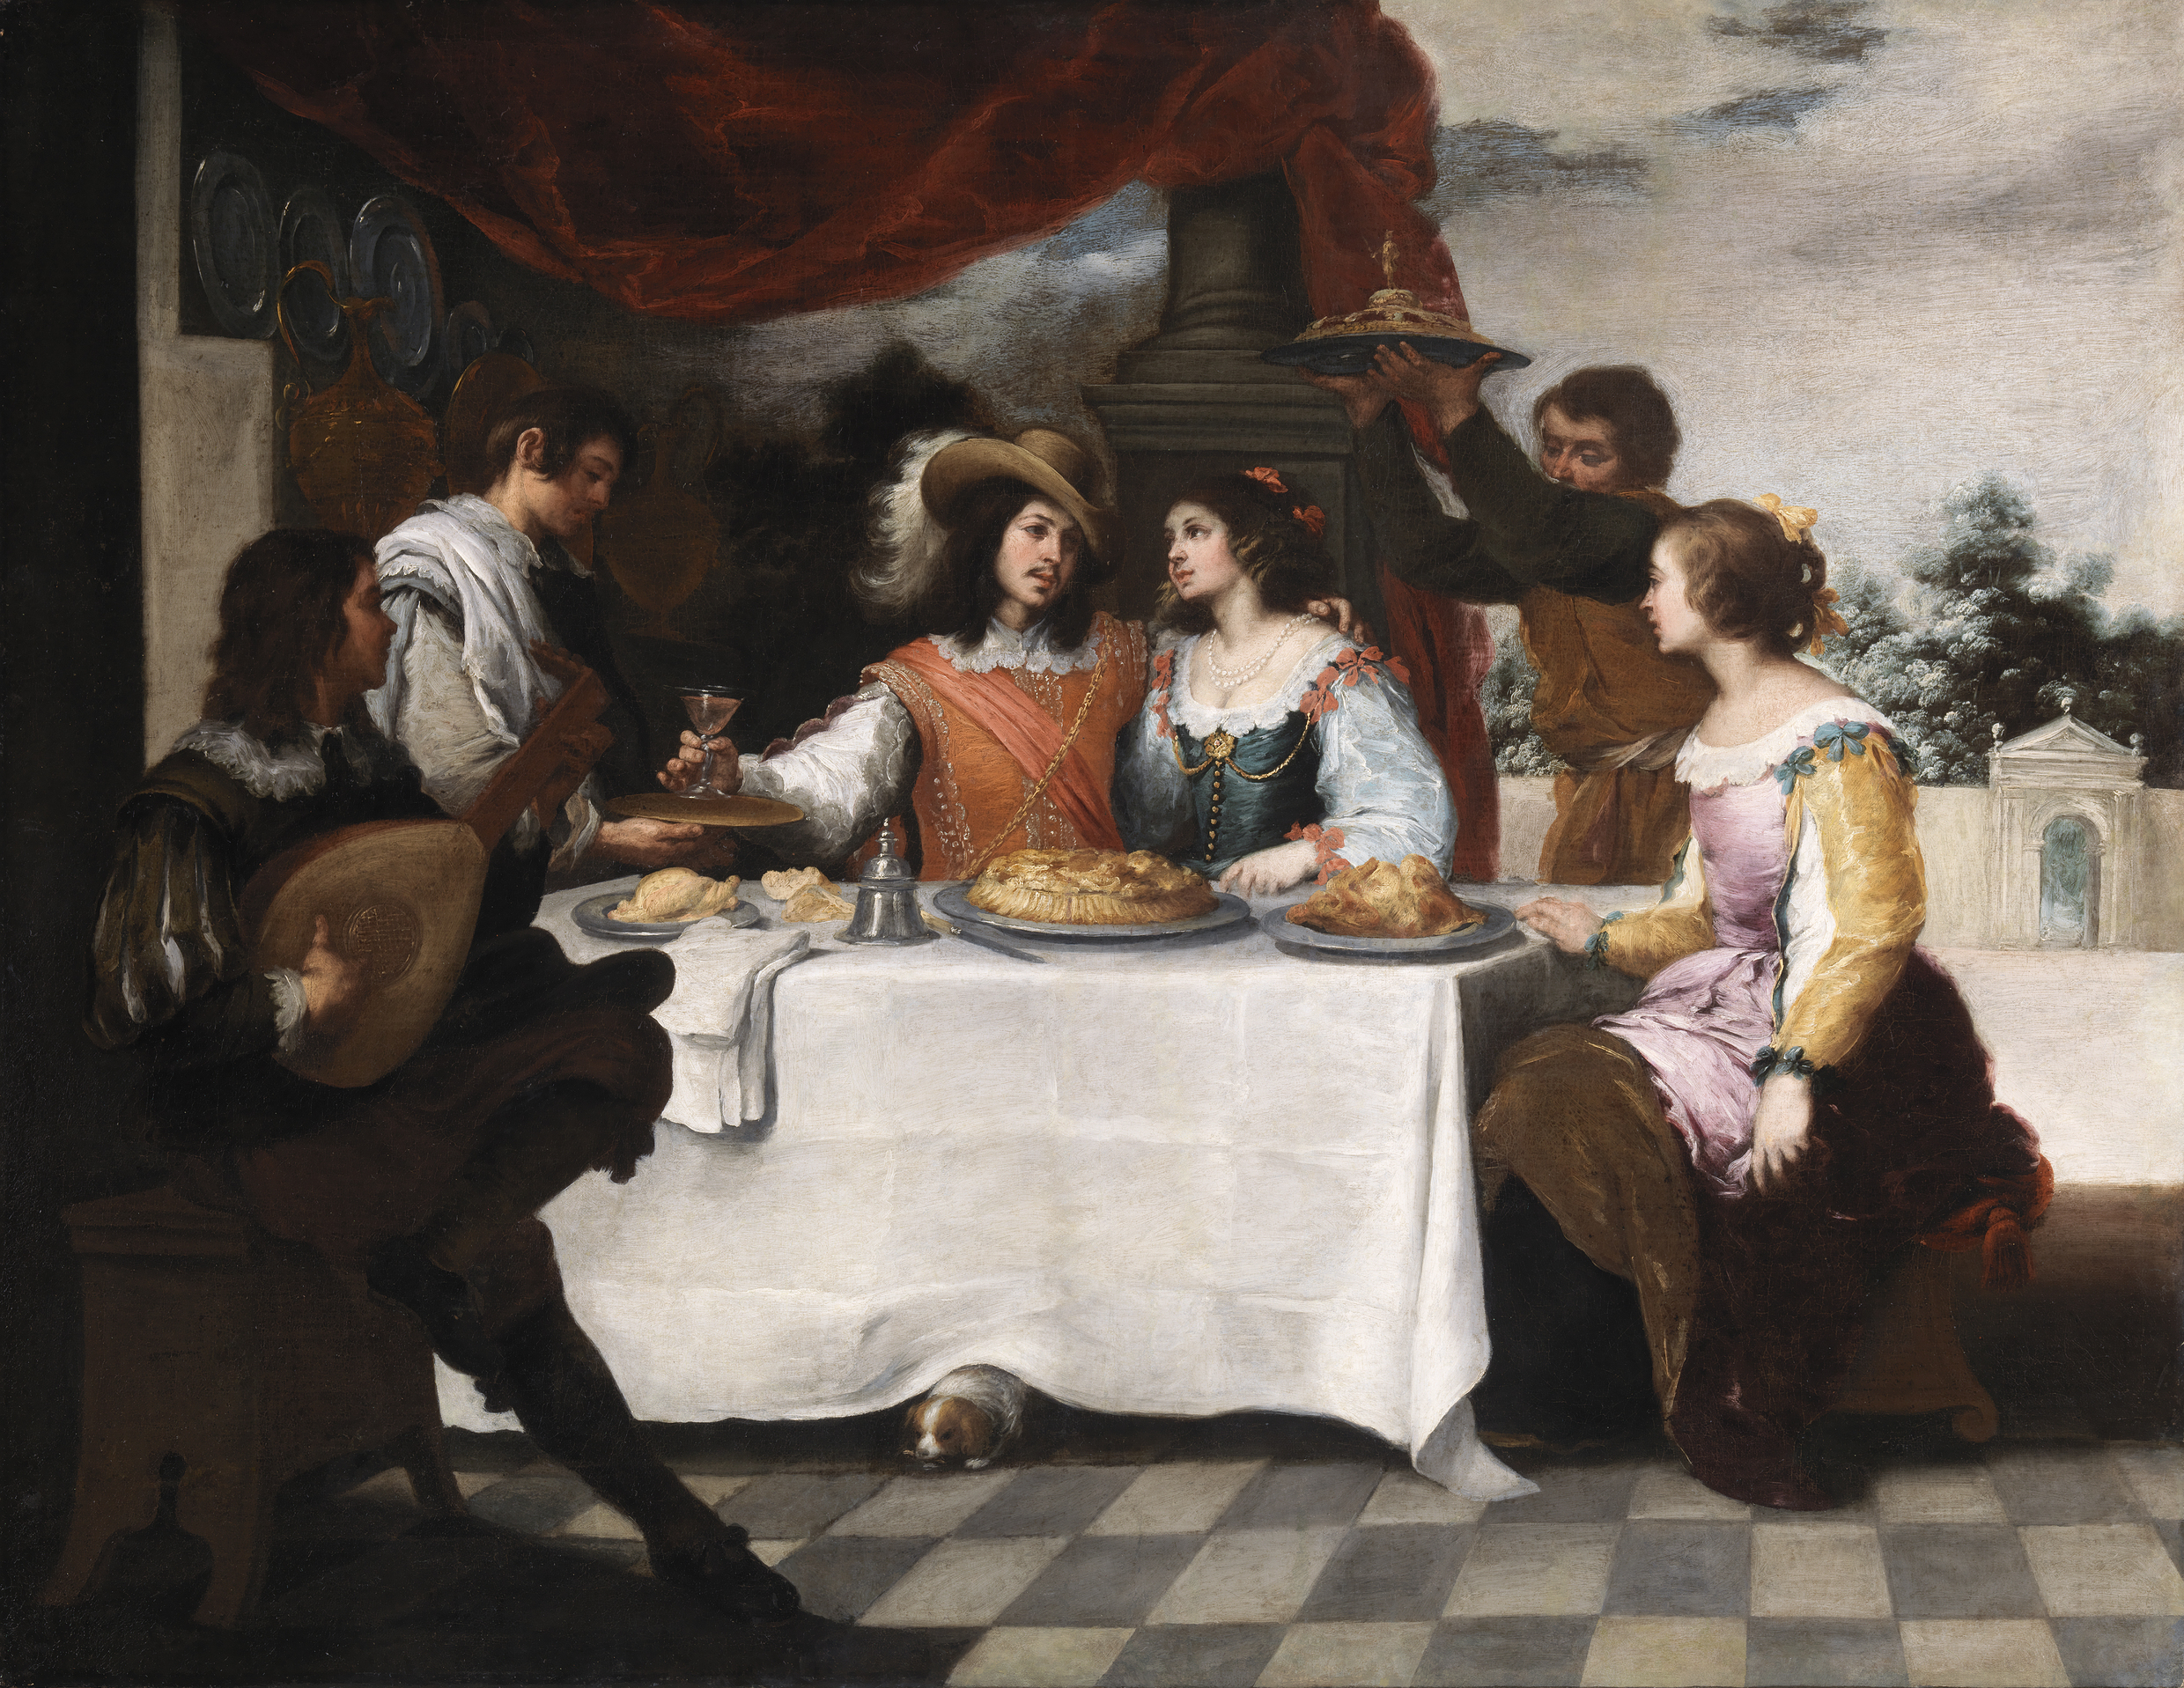
The Story
The youngest son enjoyed spending his money, having parties and making lots of new friends.

Slide 17
The Story
But soon the youngest son had spent all of his money and couldn’t afford to pay his bills anymore. The people were angry with him and chased him away.

Slide 18
The Story
The son was very hungry and had no place to live, so he decided to get a job. He was given a job feeding pigs but no one gave him anything to eat.

Slide 19
The Story
The son was very sad and very sorry for what he had done. Back home, even his father’s hired men were fed well. He decided to go back home, say sorry and ask his father for a job as a servant. When the father saw his youngest son returning, he was filled with great joy and ran to greet his returning son. He hugged and kissed the boy.
While the younger brother had been away, the older brother had been working hard for his father and saved all of his inheritance. When he heard that his brother had returned with nothing and a great feast was being thrown for him, he felt very angry and jealous.
But the father did not want his son to be jealous and angry. “We must celebrate and rejoice,” he told his older son, “because it is as if this brother of yours was dead and has come to life; he was lost and has been found.”

Slide 20
Look & Respond
What do you see in this picture?
How many people are in the picture?
Who do you think they are?
Where do you think they are?
Who do you think is the man on the right?
What do you think he is saying?
Who do you think is the man sitting at the table?
What is he saying?
Who do you think is standing behind him?
Can you describe their clothes?
How many colours can you see?
What are the main 4 colours that Murillo uses in this painting?
Where is the light coming from in the picture?
How do you think the parents are
feeling?
What do you think the eldest son is
feeling and why?
Notes:
Answers;
Ask children to describe his clothes and why he might be wearing these type of clothes
A broken Irish stone cross
Symbolism of the fall of Irish rule due to his arrival in Ireland
Proud / arrogant / happy – look at his stance and facial expression to determine
His soldiers
Marching / celebration music?
Several in the painting
Their appearance – in armour, on horseback, with banners

Slide 21
Look & Respond
What is happening in this painting?
Which person do you think is the Prodigal Son?
How does he look – what is he wearing now?
Who is he is hugging / talking to?
What do you think he is saying?
How do you think he is feeling?
Who do you think are the other people?
Do you see the older brother?
How do you think he is feeling here?
Notes:
Answers;
Ask children to describe his clothes and why he might be wearing these type of clothes
A broken Irish stone cross
Symbolism of the fall of Irish rule due to his arrival in Ireland
Proud / arrogant / happy – look at his stance and facial expression to determine
His soldiers
Marching / celebration music?
Several in the painting
Their appearance – in armour, on horseback, with banners

Slide 22
SPHE: Emotions
Relating to the story, discuss with the children the emotions the characters in the story might have felt;
How do you think the father felt when his son left?
How do you think his mother feels? How do you know this from looking at the painting?
Imagine how you might feel if someone you loved went away.
Draw faces to display how you might feel.
You might also want to go on to discuss other emotions maybe linked to when the person they love returns. You could give them cards with the emotion on them and they have to match the word to the face. Alternatively give them the words that describe the emotion and they have to draw the face to go with the word.

Slide 23
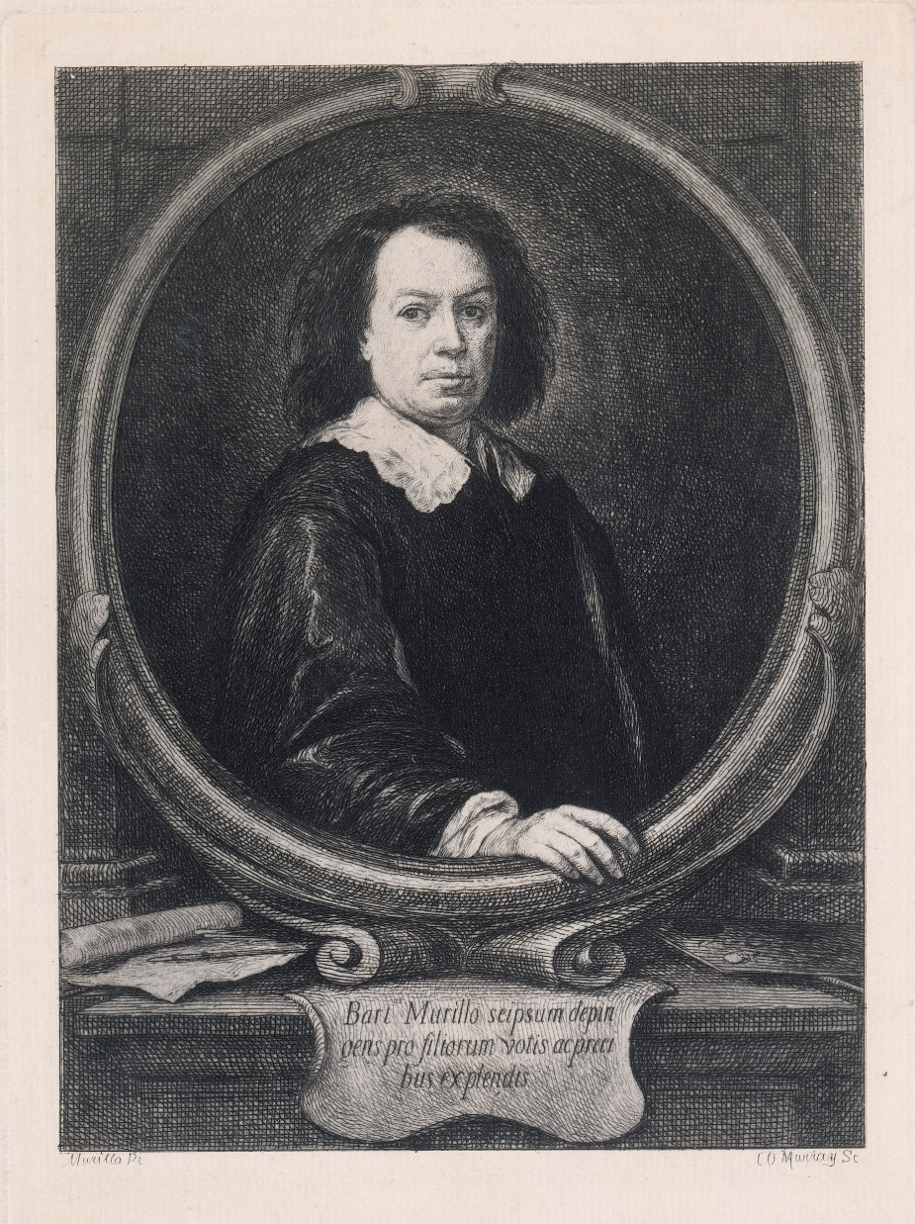
Bartolomé Esteban Murillo
Murillo was born in Spain in 1617. He was the youngest son in a family of fourteen children! His father was a barber and surgeon. After his parents died in 1627 and 1628, when he was just 10 and 11, his sister's husband, Juan Agustín Lagares, became his guardian and he lived with them. Murillo rarely used his father's surname, and instead took his surname from his maternal grandmother, Elvira Murillo.
Murillo was a Baroque painter. Baroque art often has;
great drama happening in the pictures, rich and deep colours, and intense light and dark shadows.
Can you see these in his paintings?
Murillo spent his life working as a painter, mainly painting religious pictures for churches and monasteries. He died in Seville in 1682, a few months after he fell from a scaffold while working on a fresco at the church of the
Capuchines in Cádiz.

Slide 24
Additional Activities
Primary Language - Oral / Writing / Reading
Tell this story in parts - Story sequencing - See if the children know the order of events with the use of story sequencing cards.
Life as a farmer - In the story one of the sons has to work on a pig farm to earn money. Think about what it might be like to work on a farm and write sentences on what you think it might be like.
Adjectives - In the story there are lots of emotions. Describe a time when you were joyful, or lonely, or happy.
Drama
Freeze Frame the picture and photograph this for the Gallery - ask pupils to depict the sequence of events through a series of scenes, each representing a character at this significant moment.
Role-play - In groups of three get the children to act out the story in their own way
Maths
Money - Think about what the son might have spent all of his money on?
Imagine teacher gave you €500 – Write a list of what you would spend your money on including estimated prices for each. Make sure you don’t spend more than you have!
SPHE
Emotions – recognising facial expressions and emotions – discuss how we can read how people are feeling from their facial expression. Draw out or make the face of different characters at different times in the story.
In the story there are lots of emotions. Describe a time when you were joyful, or lonely, or happy.

Slide 25
Additional Activities
Art
Paint and Colour – mixing colours to make reds, blues or browns
Paint and Colour – buildings in the paintings – mixing colour - draw out lots of buildings and paint each one a different shade / tone of brown
Drawing – Comic Strip of the story (worksheet attached)
Drawing – drawing animals – the horse and pigs
Fabric and Fibre montage of the Prodigal Son on his horse
History
Timeline of events – cut out the events in the story and give to pairs – ask the children to place the sections into the correct order.
Religion
Find out about other parables from the New Testament
Write your own parable – make sure it has a moral or saying at the end
Science
Farm life - Look at where pigs usually live and the other animals that live on a farm. See if you can visit a farm and then write about the trip. See if the children can tell you what foodstuffs come from farm animals.
Food - In the story the father lays on a huge feast. Think about what might have been included in the feast? Discuss what was healthy and what wasn’t. Put together
a feast that we might have today and
make sure that there is healthy food too – include all of your five a day.

Slide 26
Resources
National Gallery of Ireland
Objects – Bartolomé Esteban Murillo – Artists – National Gallery of Ireland
Murillo: The Prodigal Son Restored | National Gallery of Ireland
The story of the Prodigal Son
The Prodigal Son Differentiated Sequencing Worksheet (twinkl.ie)
Bible Parables for Children Resource Pack (teacher made) (twinkl.ie)
Murillo
Bartolomé Esteban Murillo (1617 - 1682) | National Gallery, London
Bartolomé Murillo - Students | Britannica Kids | Homework Help
Music
Music History: The Baroque Period (teacher made) (twinkl.ie)

Slide 27
Worksheets
These are also available as downloadable Word documents

Slide 28
Class Survey: Forgiveness (Part 1)
Question | Student 1 | Student 2 | Student 3 | Student 4 | Student 5
Is forgiveness important? Explain your answer
Is forgiveness easy? Explain your answer
Do you think forgiveness should be given with punishment? Explain your answer
Have you ever had to ask for forgiveness?

Slide 29
Class Survey: Forgiveness (Part 2)
Question | Student 1 | Student 2 | Student 3 | Student 4 | Student 5
What happened?
How did you feel? Explain your answer
What did you do to make up for your mistake? Explain your answer
How could we use our Friends Values to encourage forgiveness?

Slide 30
Forgiveness: Think / Pair / Share and fill in
Would you forgive the following?
Your friend copies your homework.
Your favourite toy is broken by your brother / sister.
Your phone is stolen by someone you know.
Someone bumps into you on yard.
Your best friend tells everyone your secret.
Forgiveness rules Imagine you are being asked for forgiveness. Write 5 things that could or should happen for you to forgive
1
2
3
4
5

Slide 31
Saying Sorry (Part 1)
Do you think the Prodigal Son said sorry to his parents and brother?
Talk to your partner about what you think the word ‘sorry’ means.
The word sorry can mean a few things;
If something bad has happened to someone, you might feel sorry for them. You might say, “I’m sorry that you hurt your arm”;
‘Feeling sorry’ is when you have done something wrong and regret it so you might say, “I’m sorry that I shouted at you”;
Sometimes, you can say the word when you are asking someone a favour. You might say, “Sorry, could I please borrow a pen?”

Slide 32
Saying Sorry (Part 2)
When might you have to say sorry?
When you have not told the truth? | When you have had an argument with someone? | When you have left someone out and not played with them?
When you have not kept a promise? | When you have been rude to someone? | When you have been angry and have hurt someone?
Talk about a time when you apologised to someone and why. How did it make you both feel?
What makes a good apology?
I am sorry for ….. I was wrong because …. Next time I will ….

Slide 33
Story Writing - Modern Day Parable
Write your own modern day version of the parable of the Prodigal Son. Use this template to plan your story.
Setting
Characters
Main plot / Main issue
Response from the other characters
Meaning behind the story
Similarities between your story and the story of the Prodigal Son
Differences between your story and the story of the Prodigal Son

Slide 34
Drawing – A Narrative Cycle
These paintings are known as a narrative cycle - a series of paintings that present a story over a number of canvases - like an elaborate comic strip. Draw your own comic strip version of the story.
1. | 2. | 3.
4. | 5. | 6.

Slide 35
Contact us
Sign up to the Teachers & Schools email newsletter to be regularly updated with new ideas and resources.
Catherine O’Donnell
Education Officer
With responsibility for Teachers, Schools & Youth
T: +353 (0) 1 663 3579
E: codonnell@ngi.ie

