Slide 1

Learning Through Art:
History
Resource Pack
Sinéad Hall

Slide 2
Introduction
Learning through art is at the heart of the National Gallery of Ireland’s primary school programme. Art helps us to understand the world and can be used in the classroom to engage with themes and subjects across the curriculum. Our series of Learning Through Art resources are designed as practical toolkits to enable you to use artworks as primary sources and inspiration for lessons in other core curriculum areas.
Contents
How to use this resource ……………………………..…… 3
Learning Objectives …………………….......................... 4
The Workshop ………………………………………….………. 5
Additional Activities ……………….………………….……. 19
Resources …………………........................................... 21
Worksheets ………………………………………..…….……. 22
Contact us …………... ……......................................... 26
About the author
Sinéad Hall BA, PGD ED, CRS, MA ED is a classically- trained pianist, and passionate educator with nearly two decades of experience teaching in Irish and American classrooms. Sinéad has earned degrees in Music, Human Development, Gaeilge, a Postgrad in Education, and a Masters in Leadership and Management. She teaches 5th class in Ratoath SNS, is a Visual Arts tutor and a research supervisor for the Primary Masters of Education with Hibernia College. Her passions include playing the piano, art, watersports, her two children, her Schnauzer dogs, good coffee and music. Sinéad is active in the community and in her free time can be found scouting, teaching in her art club
and surfing.

Slide 3
How to use this resource
This is part of a series of practical guides to teaching different curriculum areas through art.
Each resource provides you with:
A PowerPoint slide show for you and your class to read through
Images of a key artwork from the Gallery’s collection
Information about the painting and the artist
Looking and responding questions to ask your class
Discussion points
Curriculum-linked lessons based on the work
Worksheets to print out and use along with the lessons
A resource list of additional websites that you can use for further research and reading
Additional lesson ideas for other subjects

Slide 4
Learning Objectives
The child should be enabled to:
look at and talk about the work of artists
describe what is happening in the painting;
  the colours and tones chosen
  the lines, shapes, textures and pattern created
  how they are arranged in the painting
  how colour was used and effects created
  what he/she or the artist was trying to express
  what he/she likes best about the painting
respond to the work of artists through designed lessons

Slide 5
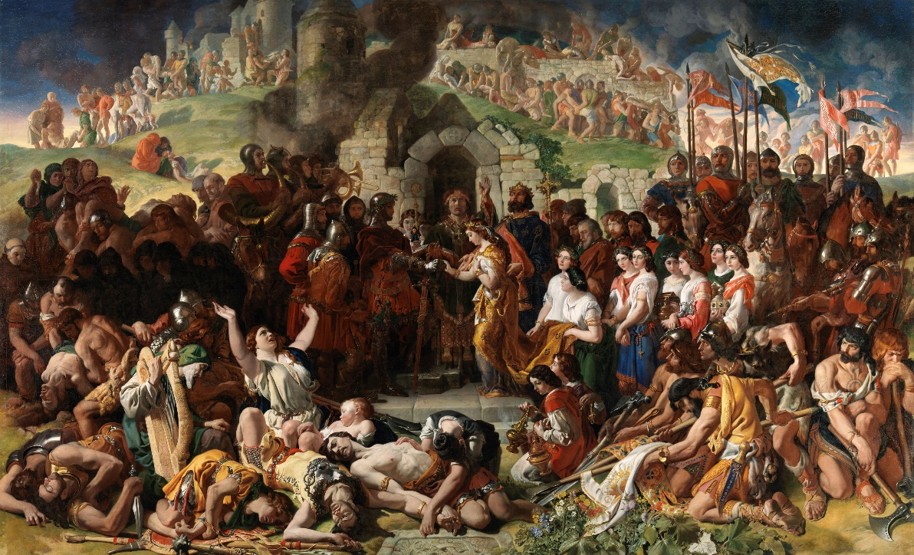

The Workshop
Also available as an adaptable PowerPoint slideshow

Slide 6
The Marriage of Strongbow and Aoife, c.1854
Daniel Maclise (1806-1870)
Presented, Sir Richard Wallace, 1879. Photo © National Gallery of Ireland.

Slide 7
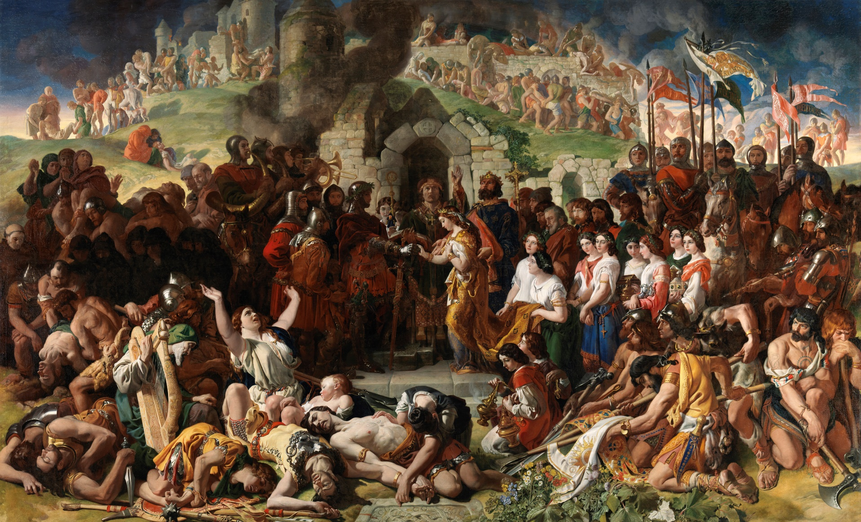

Slide 8
We can learn a lot about history from paintings
This is one of the largest and most important paintings in the National Gallery of Ireland (over 5 x 3 meters!)
It tells the story of a very important event in Irish history – the wedding of Strongbow and Aoife.
The painting tells us a lot about them, and about their story by showing the events that led up to the wedding through symbols.
But who were they and why was their wedding important?

Slide 9
The Story
This wedding took place in Ireland in 1170.
Diarmaid Mac Murrough had been the King of Leinster but he was deposed by Rory O’Connor who then became the High King of Ireland.
Diarmaid was not happy about this, so he went to England for help to get his Kingdom back. There he met Richard de Clare, known as Strongbow, who said he would help him.
In return Diarmaid promised his daughter, Aoife, to Strongbow. He also promised that he would become King of Leinster when Diarmaid died.
Quick Think – Pair - Share – why do you think Richard was given the nickname Strongbow?

Slide 10
What happened?
In 1170 Strongbow arrived in Ireland with a skilled, well armed and professional army. He captured and burnt the city of Waterford in just 3 days, and this was just the beginning of his journey.
In the painting we see the city of Waterford fallen, broken and burning beneath dark, stormy skies in the background as Aoife takes the hand of Strongbow in marriage.
We see the bodies of Irish soldiers who stood against Strongbow – it is a violent picture of terror, spears, swords, killing and plunder.
Aoife’s father Diarmaid stands by in his golden crown with his hand on her back.

Slide 11
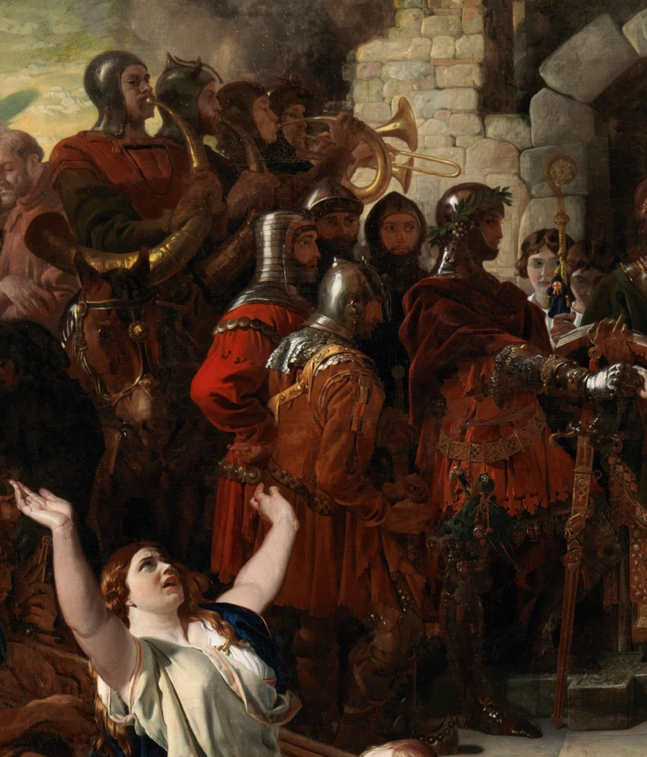
Look & Respond: Strongbow
What is he wearing?
What can you see under his foot?
What do you think this means?
How does he look - how do you think he is feeling?
Who is standing behind him?
What kind of music do you think the bugle / horn players are playing?
Can you see any other soldiers of Strongbow?
How can you tell they are Strongbow’s soldiers?
Notes:
Answers;
Ask children to describe his clothes and why he might be wearing these type of clothes
A broken Irish stone cross
Symbolism of the fall of Irish rule due to his arrival in Ireland
Proud / arrogant / happy – look at his stance and facial expression to determine
His soldiers
Marching / celebration music?
Several in the painting
Their appearance – in armour, on horseback, with banners

Slide 12
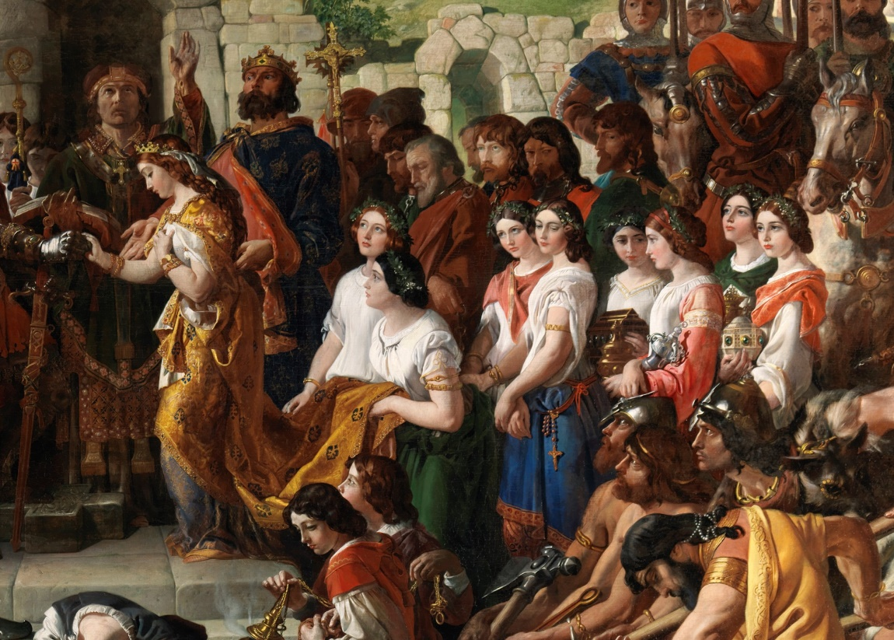
Look & Respond: Aoife
What is Aoife wearing?
How does she look – how do you think she is feeling?
How many bridesmaids can you see?
How are they dressed?
Who do you think they are?
Notes:
Answers;
Describe colours of her clothes, her jewellery and crown
Sad / happy / scared / determined? – she was only 17 at the time
10
Some jewellery, cross and beads, thurible for incense at mass, flowers in their hair – symbols of Christian Ireland
Her friends / sisters / family members?

Slide 13
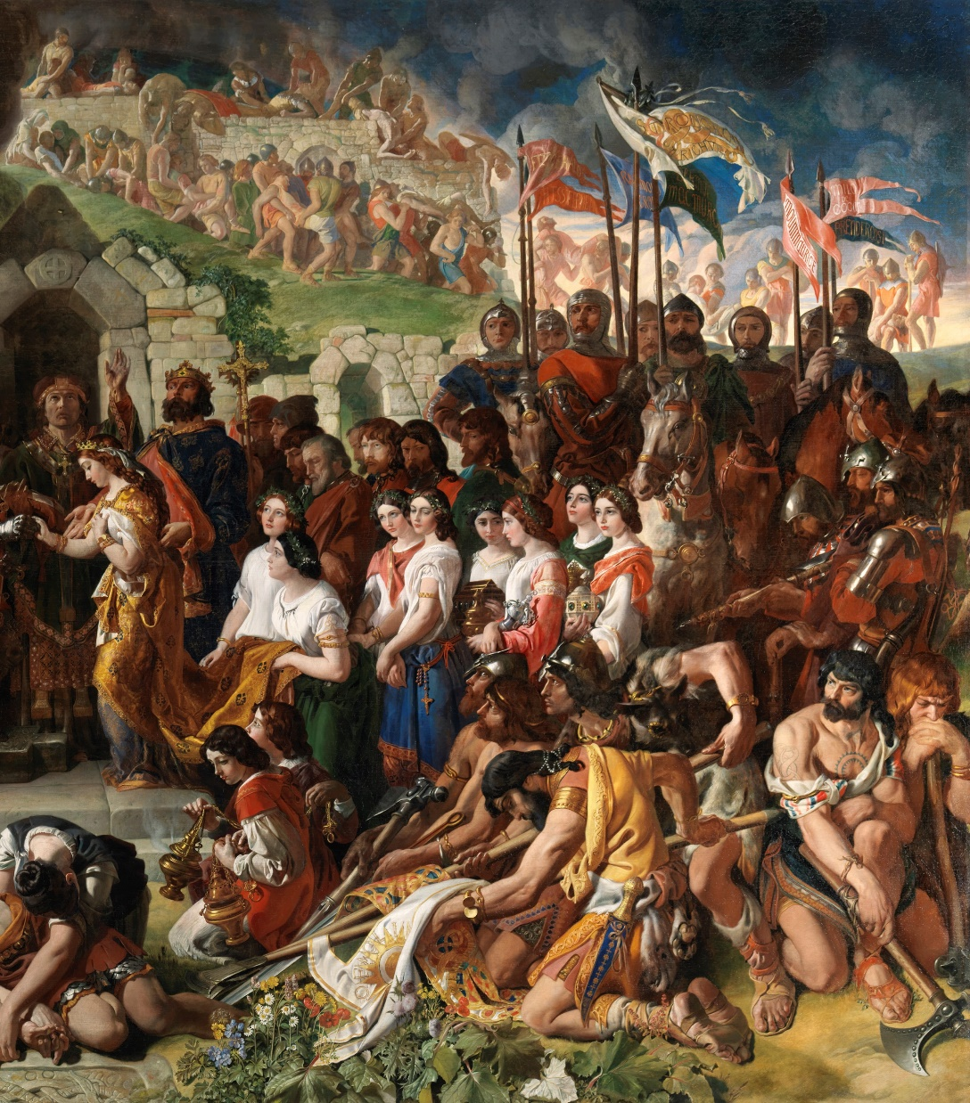
Look & Respond: Diarmaid Mac Murrough
Where is he standing?
What is he wearing?
How does he look - how do you think he is feeling?
What does the gold cross tell us?
How do Diarmaid’s friends and followers look – how do you think they are feeling?
How do they look compared with the soldiers behind them?
Notes:
Answers;
Behind Aoife
Describe his clothes
Proud / puzzled / worried / happy / anxious?
Christian faith
Sad / downcast / worried
Very obvious differences in clothes and facial expressions, in wealth and position / power

Slide 14
Symbols in the painting
Can you see anything in the painting that might be a symbol?
Some ideas:
The dark and stormy skies
The burning, falling buildings
The dead bodies
The weapons on the ground
What might these all mean?
Notes:
Ideas – these all symbolise the trouble ahead that Diarmaid and Strongbow bring to Ireland
The upcoming battles and overtaking of cities, especially Dublin
The eventual arrival of the King of England and his rule over Ireland

Slide 15
Symbols in the painting
The Harper
Can you see a harp player?
What do you notice about his harp?
What might this mean?
What is the harp a symbol for?
Where would you see the harp symbol used today?
Flowers
Can you see any flowers in the painting?
What do you think they mean?
What might they also tell you about the painter?
Notes:
The Harper
Ask the children to find him
The strings are broken
Broken lineage of Irish rule in Ireland
For Ireland
On coins
Flowers
Ask the children to find them
Hope
Showing his skill as a painter

Slide 16
How does the story end?
Think – Pair – Share - about how you think the story of Strongbow, Aoife and her father Diarmaid ended.
Fill in this KWL worksheet or write it out in your copy.
Read your answers to the class.
What do we know? | What do we want to find out? | What have we learned?

Slide 17
How the story ends
Strongbow and his army go on to capture the towns of Wexford and Dublin – this is the first Norman invasion of Ireland.
In 1171, one year later, Diarmaid dies and Strongbow becomes the king of Leinster.
Aoife and Strongbow have two children – Gilbert and Isabella.
King Henry II, fearing Strongbow was becoming too powerful, comes to Ireland and declares himself Lord of Ireland – he is the first English king to set foot in Ireland.

Slide 18
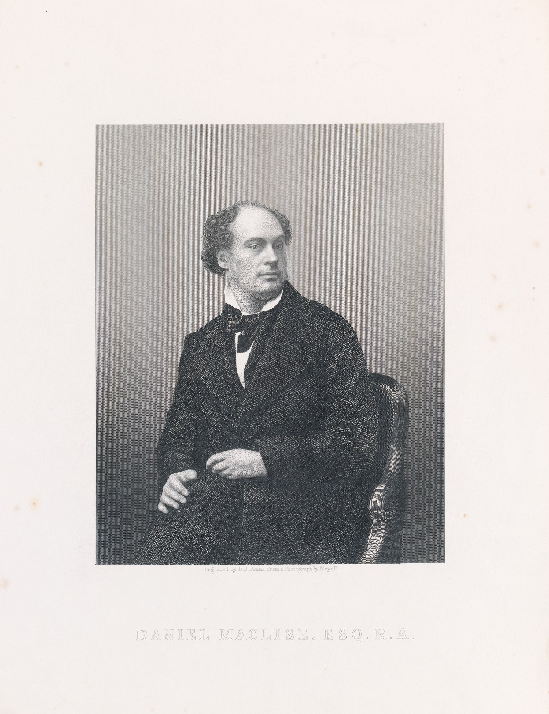
Daniel Maclise
Maclise was a historian and painter from Co. Cork. He lived from 1806 to 1870. He spent most of his adult life living in England.
His education in Cork was of the plainest kind, but he was very interested in culture and reading, and he was anxious to become an artist. His father, however, got him a job working in the bank, where he remained for two years, before leaving to study at the Cork School of Art.
He became a well known artist and was particularly good at drawing people. He drew caricatures of famous people for a magazine. He also designed illustrations for several of Dickens's Christmas books.
He died of acute pneumonia on 25 April 1870 at his home in England.

Slide 19
Additional Activities
Primary Language - Oral / Writing / Reading
Tell this story in 3 parts
What happened just before the wedding
Describe what’s happening in the painting
Predict what will happen next
Life as a Norman solider - In the story Strongbow arrives in Ireland with his soldiers. Think about what it might have been like to arrive into Ireland as one of his soldiers – write a diary entry of the day you arrived in Waterford.
Drama
Freeze Frame the picture and photograph this for the Gallery - ask pupils to depict the sequence of events through a series of scenes, each representing a character at this significant moment.
Conscience Alley (see worksheet)
Dramatize each part of your written story
History
Timeline of events – research and write out the timeline of events
1. Diarmad’s trip to England and finding Strongbow
2. Strongbow's arrival and conquering of Ireland
Research Strongbow – where he is buried
Motte and Bailey castles – research about life in a Norman castle
Geography
On a map of Ireland, map out Strongbow’s arrival and travels through Ireland

Slide 20
Additional Activities
Art
Painting of cloudy skies – colour mixing blue, white and black
Fabric and Fibre montage of Aoife or Strongbow
Construction Diorama of the story
Construction – make a motte and bailey castle
SPHE
Emotions – recognising facial expressions
Empathic response
Religion
Find out more about the religious symbols in the painting
The Irish stone cross
The thurible
Use of incense

Slide 21
Resources
National Gallery of Ireland
The Marriage of Strongbow and Aoife - the characters | National Gallery of Ireland
The Marriage of Strongbow and Aoife - the history | National Gallery of Ireland
Daniel Maclise (1806-1870) | National Gallery of Ireland
The Normans
Norman Ireland: Medieval Ireland (askaboutireland.ie)
ONLINE LEARNING, PRIMARY SCHOOLS | DUBLINIA
Normans Facts for Kids | KidzSearch.com
The Normans Come to Ireland Timeline PowerPoint (twinkl.ie)
Diarmaid mac Murchadha - Wikipedia
Novel (suitable for 5th/6th class)
Strongbow | Seomra Ranga

Slide 22
Worksheets
These are also available as downloadable Word documents

Slide 23
Conscience Alley
A useful technique for exploring any kind of dilemma faced by a character, providing an opportunity to analyse a decisive moment in greater detail.
The class forms two lines facing each other.
One person (the teacher or a participant) walks between the lines as each member of the group speaks their advice.
It can be organised so that those on one side give opposing advice to those on the other.
When the character reaches the end of the alley, she makes her decision.

Slide 24
Looking and Responding Questions
Look closely at the painting and answer the following questions.
This painting is about a marriage – Is it a celebration of marriage? Give reasons for your answer.
The artist shows native Irish people and Norman invaders – what techniques does he use to contrast the two groups?
What does the character Strongbow do in the painting that suggests his lack of respect for the native Irish and their traditions?
It is often said that Maclise was one of the most successful painters of his day. Based on this painting by him, would you agree? Give evidence from the painting to support your answer.
Research Diarmaid Mac Murrough and write 5 facts about him

Slide 25
Are you descended from the Normans?
Here are some of the most common Norman surnames in Ireland.
Butler | Dalton | Darcy | Burke | Fleming
Walsh | Barry | Roche | Campion | Joyce
Nugent | Fitzgerald | De Lacy | Savage | White
Sinnott | Morrissey | Powers | Fitzgibbon | Griffith
Rice | Plunket | Lynch | Lyons | Dillon
Do you know any famous Irish people with a Norman surname?
Research the origin of your surname.
Research and draw your family tree.

Slide 26
Contact us
Sign up to the Teachers & Schools email newsletter to be regularly updated with new ideas and resources.
Catherine O’Donnell
Education Officer
With responsibility for Teachers, Schools & Youth
T: +353 (0) 1 663 3579
E: codonnell@ngi.ie

