Slide 1

Art & Mindfulness:
Supporting Children’s Wellbeing in Primary Schools
Maria Broderick

Slide 2
Introduction
Supporting children’s wellbeing has never been more important. Mindfulness is deliberately pausing and paying attention to the present moment, without judgment. It gives us time to connect with ourselves and the world around us, fully experiencing what’s going on. We can practice mindfulness by spending time looking at an artwork. This engagement can help to calm and settle our busy minds.
Contents
How to use this resource ……………………………….…3
Step 1: Allow Time ………………………........................ 4
Step 2: Relax & Breathe ……………………………………. 5
Step 3: The Five Senses ……………………………………. 7
Step 4: Yoga ………………………................................... 9
In depth: Powerscourt Waterfall …………...……..... 15
About the author
Maria Broderick MAVA(NCAD), Dip. Hist. of. Art (Galileo Galilei), Dip. Hist. of. Art (TCD), B.Ed (St. Pats), is the Deputy Principal in St. Mary’s Woodside N.S., Sandyford and is also a tour guide at the National Gallery of Ireland. The highlight of her studies in Art History came when she spent four months studying in the beautiful city of Florence. Art History and Mindfulness, Maria’s two great passions, inform, enrich and support her teaching through an integrated curricular approach.

Slide 3
How to use this resource
The resource is provided as a PDF and an adaptable PowerPoint that you can use in the classroom.
We have included a step-by-step guide to incorporating mindfulness in the primary classroom, alongside an in-depth look at Powerscourt Waterfall, Co. Wicklow by George Barret.
This is accompanied by a guided mindfulness video exploring the painting which can be used in the classroom. It will also lend itself to remote teaching and could be used during a ‘live’ teaching session.
We have also included lots of creative ideas to support cross-curricular teaching.
Using artworks as the stimulus for your mindful teaching practice, let the acronym ‘ARTY’ help to guide and support your lesson. It is hoped that the children in your class will come to enjoy a deeper appreciation and understanding of artworks through this engagement.
Allow time
Relax and Breathe
The Five Senses
Yoga

Slide 4
Step 1: Allow Time
Choosing the right time in which to carry out this practice can play an important role in supporting the effectiveness and overall impact experienced by the children.
Some tips to help choose the right time:
Mindful Monday Morning (M.M.M). This will allow the children time and space to readjust to the demands of the classroom after their weekend and support and prepare them to become more receptive to learning for the week ahead.
Between core subjects. This will offer a nice break from the academic subjects and allow time to reflect and pause.
You may decide to teach this as a stand alone lesson on wellbeing or integrated to support other curriculum subjects.
Taught at the same time each day/week/ fortnight. Creating routine establishes security and familiarity for children and will also help to ensure the practice continues.
Placing a note on your classroom door during this time to ensure there are no disruptions is a good idea.
Time to Look
It is important to give looking time. Allow the children time to take in what is before them before asking questions
Top Tip!
Display a print of the work you intend to discuss on your Visual Arts wall for the week prior to
discussing it. Some children will notice it
and begin to make judgements and access
it for meaning. Some will be curious and
may ask you questions.

Slide 5
Step 2: Relax & Breathe
It is important to carry out a mindful practice with your class before presenting them with the art work. This will allow the children time to centre themselves and become present in the moment. Practising breathing techniques is a very effective way of doing this. There are many lovely breathing exercises suitable for children readily available online. For your convenience, there are some outlined here.
Same Breath
Sitting comfortably with your hands placed gently on your lap, inhale through your nostrils for the count of 2, then exhale through your mouth for the count of 2. You might like to count aloud so the children can follow your lead. Try to increase this to 3 seconds. For younger children, it is nice to explain this action as smelling flowers (inhaling) and blowing out the candle (exhaling).
Starfish Breath
Sitting comfortably, hold your left hand out in front of you with fingers spread wide apart. With the index fingers on your right hand, guide it along the outside of your baby finger inhaling as you go up the side of your baby finger and exhaling as you go down the inside of your baby finger. Continue tracing each finger and then repeat with your right hand.
Rainbow Breath
Standing tall with both feet on the floor, bring your two arms out to the side and inhale as you bring your arms above your head. Exhale as you bring both your arms to your side once again. Each time you do this, imagine you are
painting a rainbow, each time you exhale,
you add a new colour to your rainbow.

Slide 6
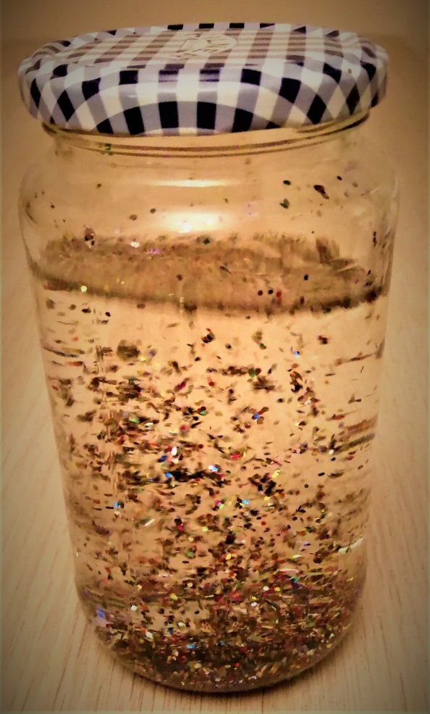
Mindful Moment Idea
Why not make a Mindful jar with your class?!
Choose a nice glass jar with a secure lid. Add water, a teaspoon of glycerine (helps the glitter to float), and different colours of glitter.
As you add each colour of glitter to the jar, explain to the children that each colour represents a different emotion we may be experiencing.
Close the lid and shake the jar. We can visually see our thoughts become jumbled up.
Sit the jar on your desk and ask the children to watch as the glitter comes to rest.
This is a lovely visual way to teach children that when we stop and rest and take time to be mindful, our thoughts and worries can rest too and it becomes easier for us to approach challenges we may be faced with.

Slide 7
Step 3: The Five Senses
Engaging with the senses is a very simple but effective way of enabling the children to experience being present and to experience a deeper and more meaningful engagement with artworks. Encourage the children to ignite their imaginations and step into the world of the painting. Become fully immersed in the work by engaging the senses.
Listed below are some questions you might like to pose to help explore each sense in turn.
What can you see?
Allow the children time to take in the scene before them. Ask them to name what they see. The more time allowed, the more details they will notice. Make connections with the Visual Arts curriculum - refer to the art elements!
What can you hear?
What sounds can you imagine hearing in this painting? Are there sounds from nature? birds singing, wind blowing through the trees, sound of water. Can you imagine stepping on crunchy leaves? Are there sounds from man made objects? Traffic, factories, transport, instruments and so on.
What can you smell?
What fragrances can you smell? Are there flowers/trees in the scene? Maybe there is a group of people...is someone wearing perfume?
What can you feel?
Look for textures in the art work. Look at the fabrics being worn, how might they feel?
What can you taste?
Is there any food visible in the art work?
I wonder what it might taste like?

Slide 8
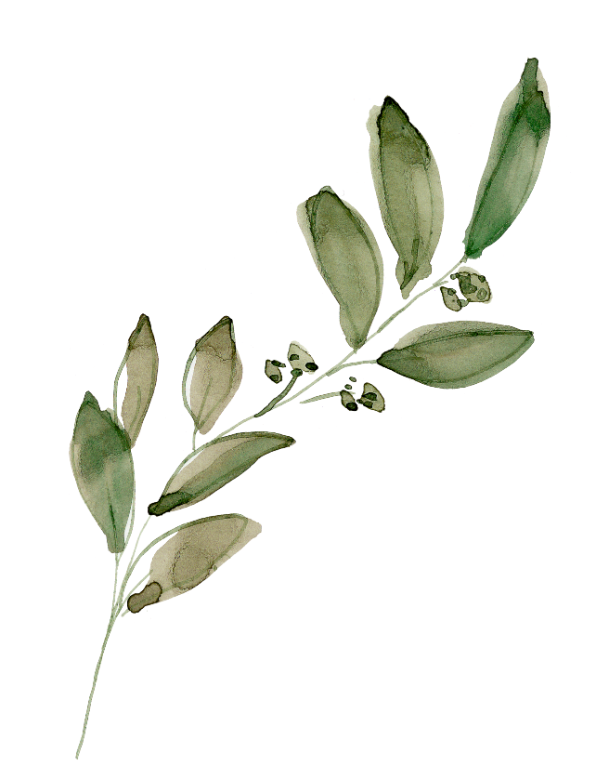
Mindful Moment Idea
Why not go on a sensory walk with your class?
Each child could make their own little art diary and document what they saw, heard, smelt, felt and tasted through note taking, making sketches and pasting in samples found.
For example, a flower that had a nice fragrance, a leaf that had an interesting texture and so on.

Slide 9
Step 4: Yoga
Yoga offers many benefits for children including supporting self-esteem, concentration and confidence. It teaches resilience and self-regulation by allowing the children to experience being in the moment. Children, particularly young children, are naturally curious and love to connect with art works by using their bodies to mirror a particular gesture, expression or pose of a figure, object or creature.
Yoga, therefore is a natural way for children to engage with and experience the artwork. There are many child friendly yoga guides available on-line.
www.cosmicyoga.com
www.relaxkids.com
www.twinkl.com
Art & Yoga
On the following slides we have provided images of popular paintings in the collection and yoga poses to explore within each work.
Yoga Stories
Why not challenge your class to create their own story inspired by the artwork using yoga poses in small groups of four to five children? It is a wonderful way to allow for creative exploration and expression. The children will often create their own poses to help tell the story.

Slide 10
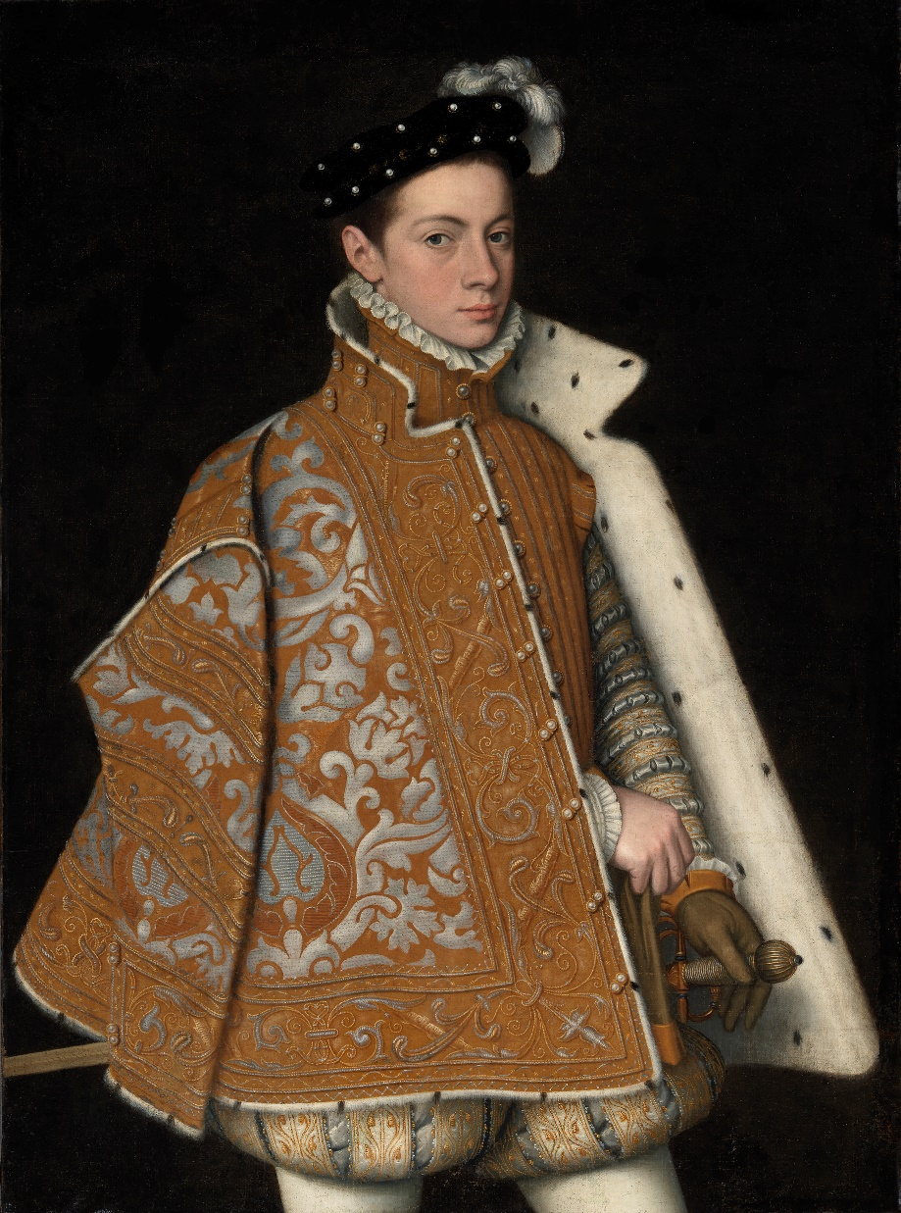
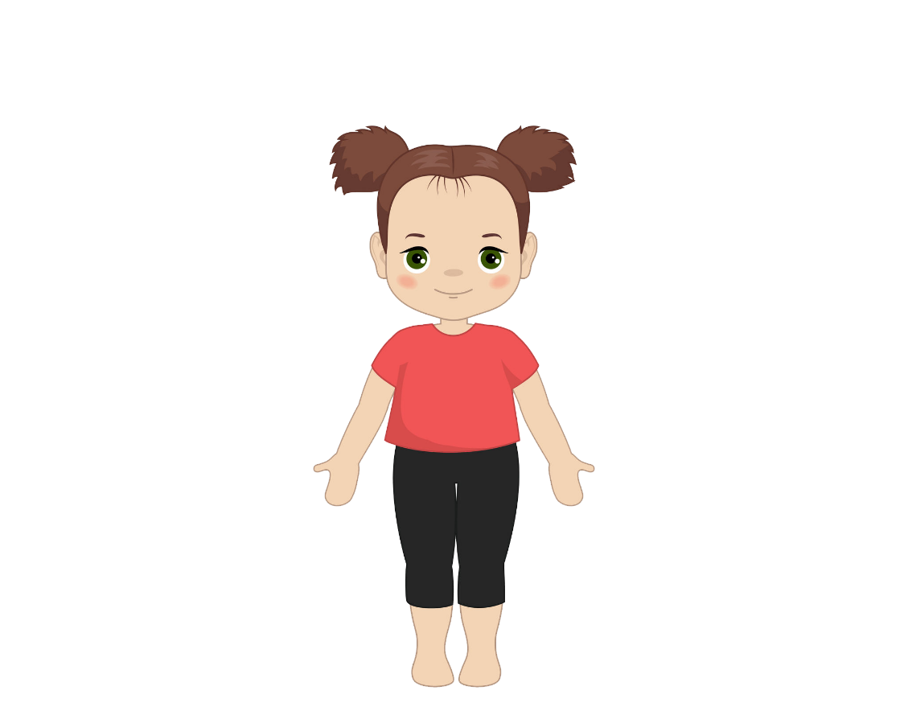
Mountain Pose
Sofonisba Anguissola (1538-1625), Portrait of Prince Alessandro Farnese, 1560. Purchased, 1864.
Photo © National Gallery of Ireland

Slide 11
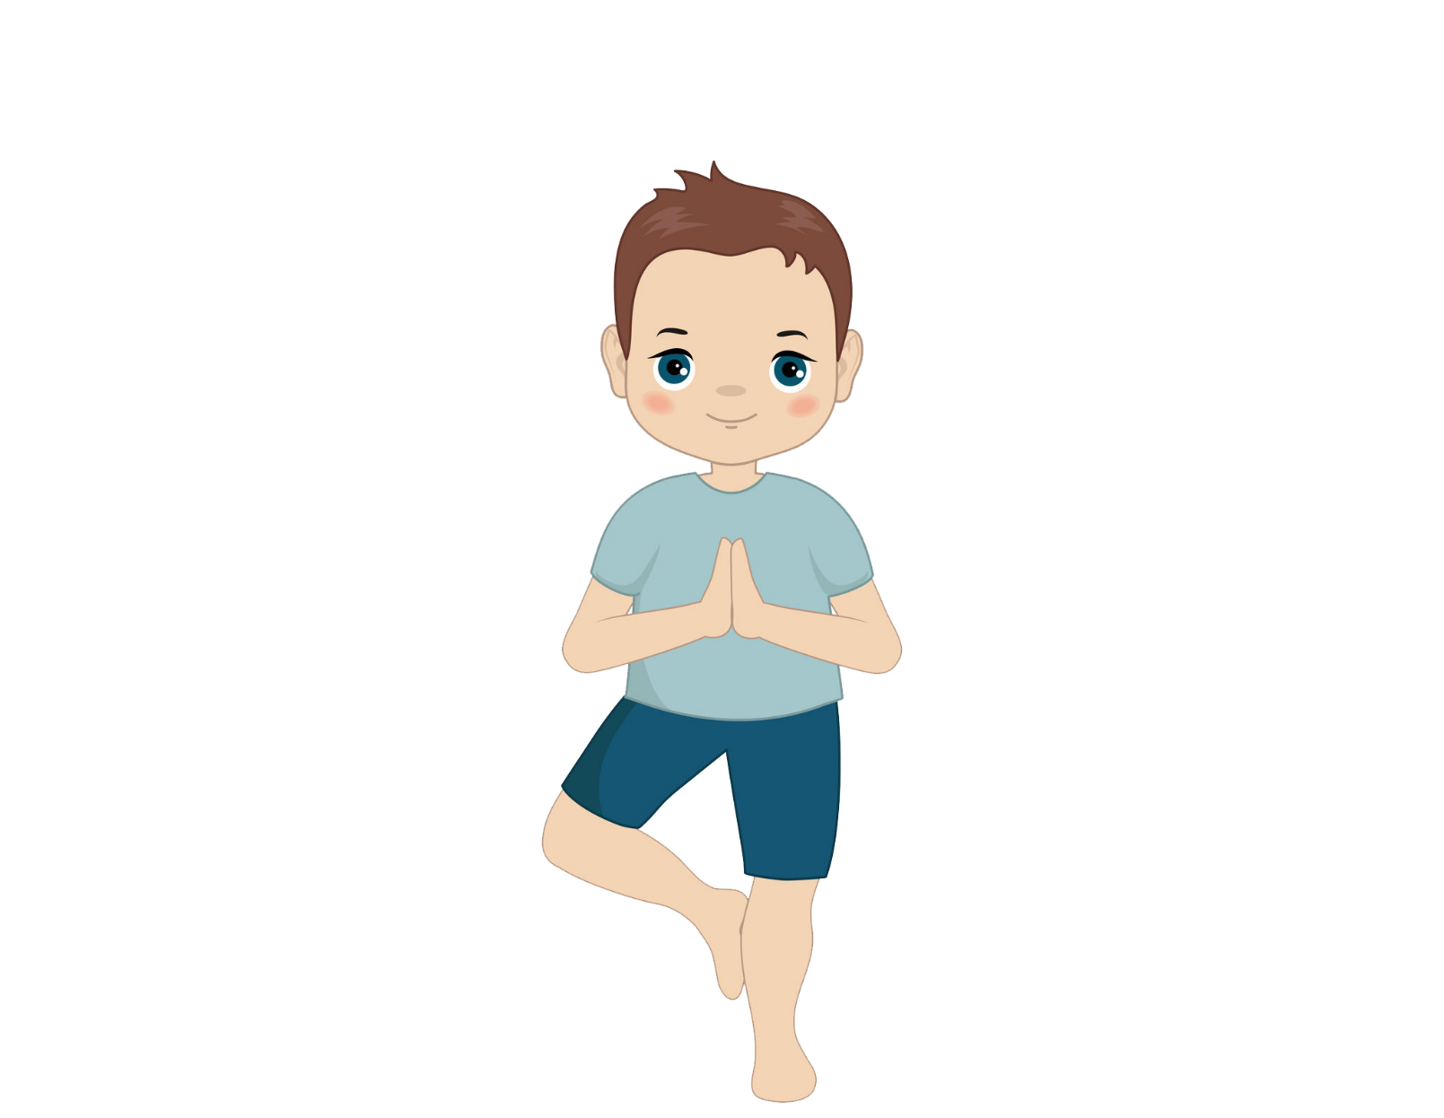
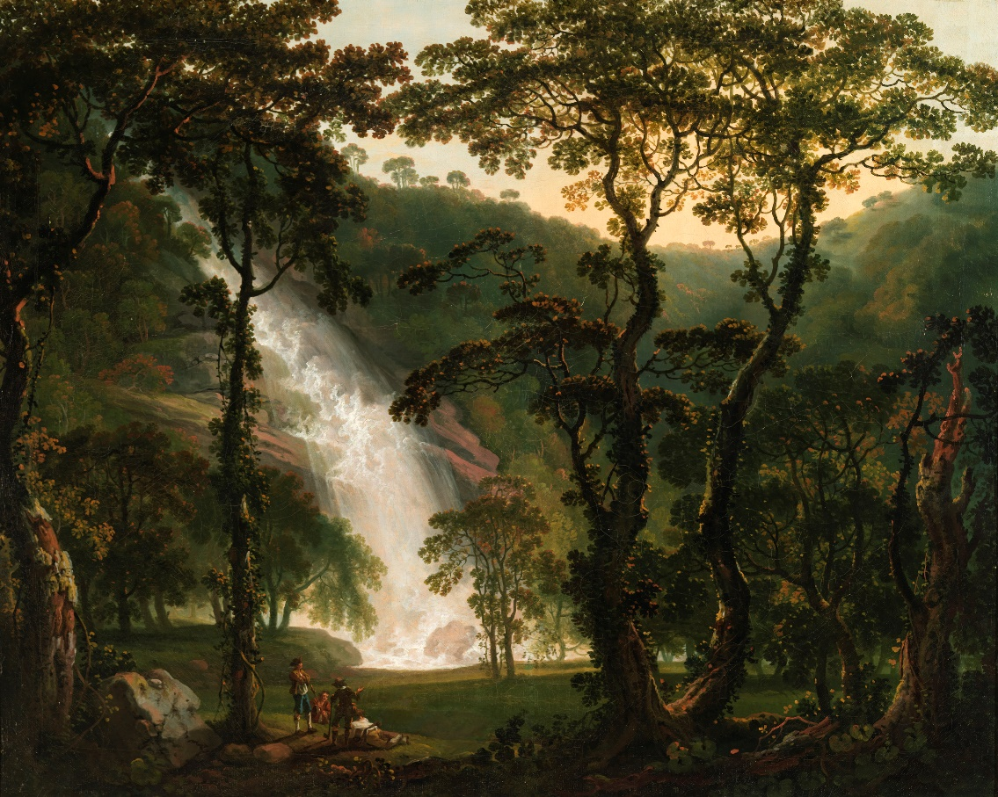
Tree Pose
George Barret (1728/32–84), Powerscourt Waterfall,
Co. Wicklow, 1760. Purchased 1880.
Photo © National Gallery of Ireland

Slide 12
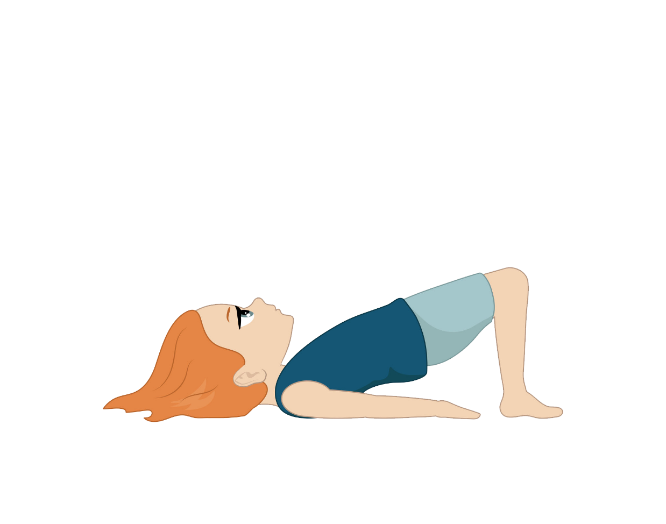
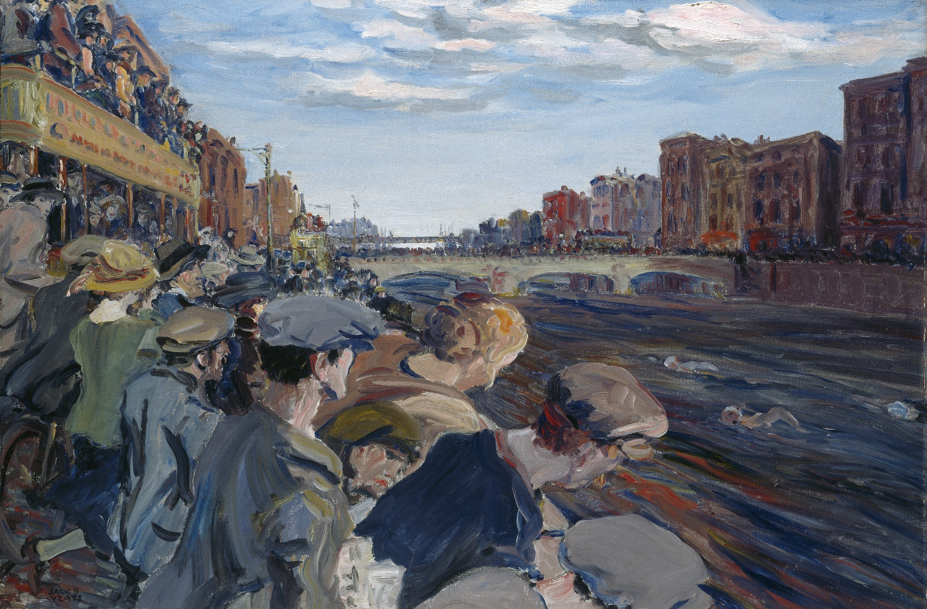
Bridge Pose
Jack B. Yeats (1781–1957), The Liffey Swim, 1923.
Presented by the Trustees of the Haverty Bequest, 1931.
Photo © National Gallery of Ireland

Slide 13
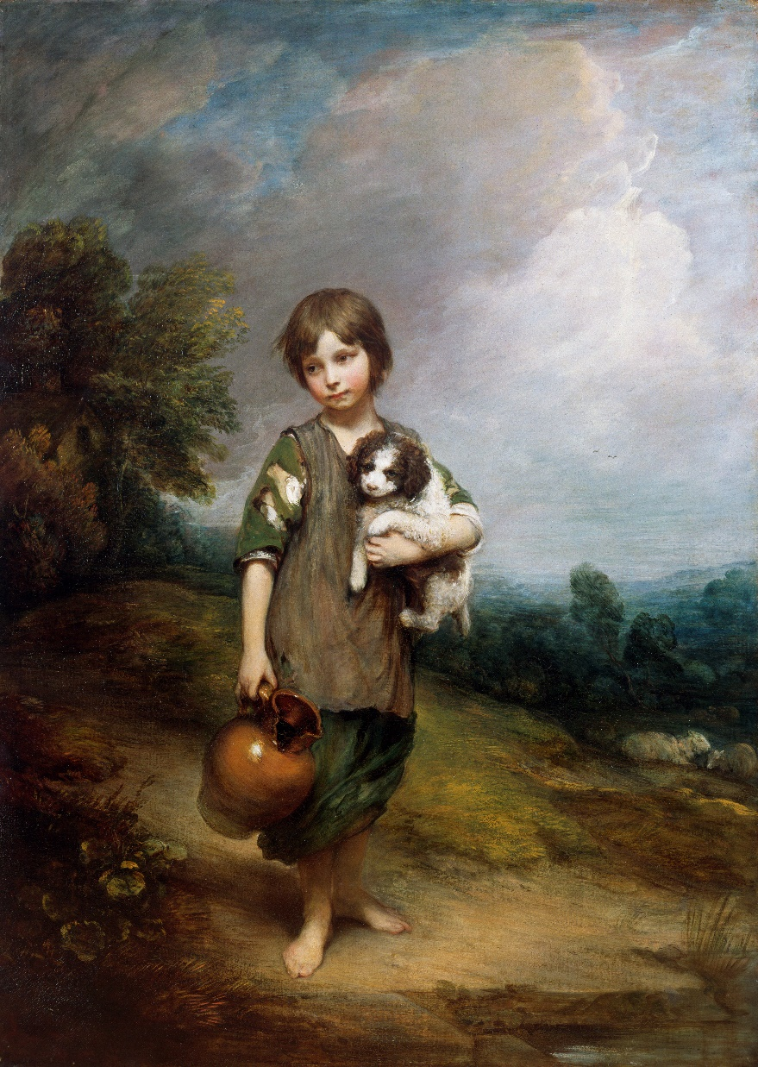
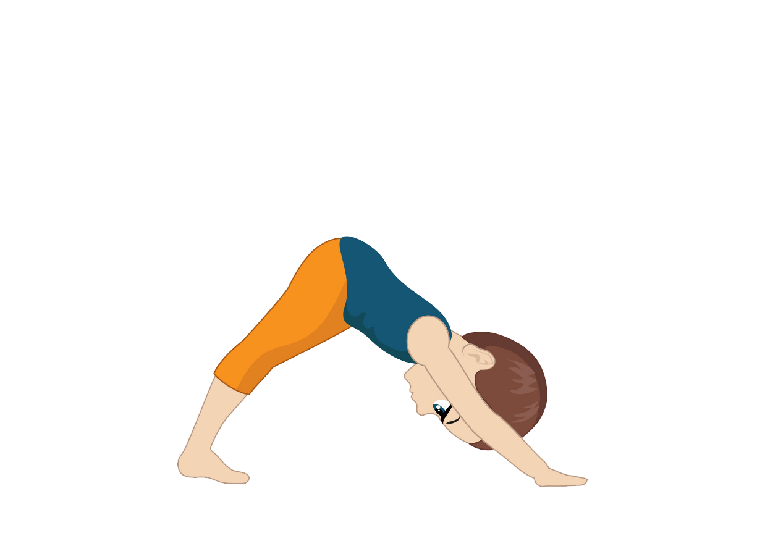
Downward Facing Dog
Thomas Gainsborough (1727-88), The Cottage Girl,
1785. Sir Alfred and Lady Beit gift, 1987(Beit Collection). Photo © National Gallery of Ireland

Slide 14
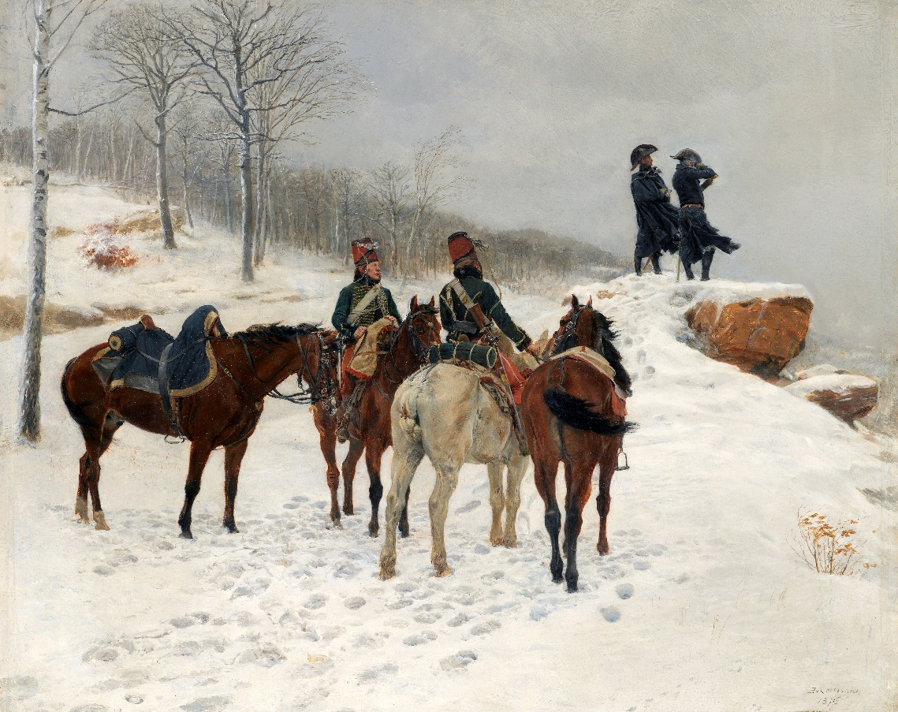
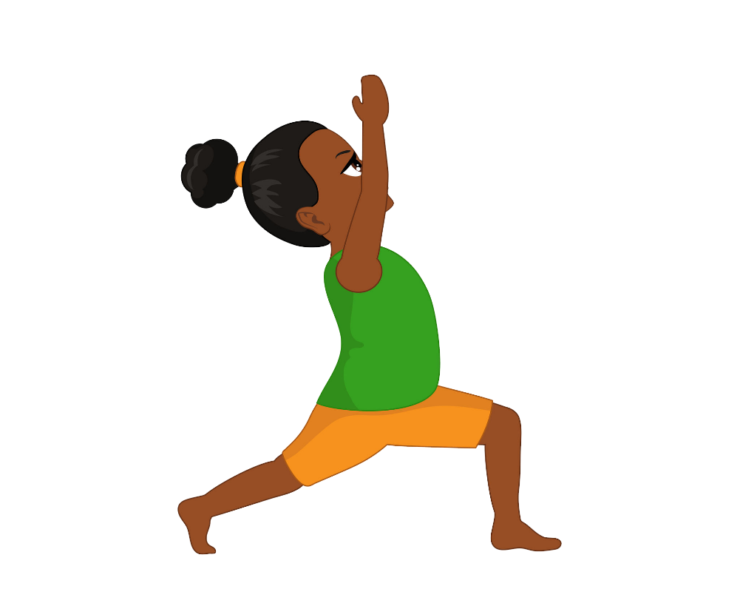
Warrior Pose
Ernest Meissonier (1815– 91), Group of Cavalry in the Snow: Moreau and Dessoles before Hohenlinden,
1875. Alfred Chester Beatty gift, 1950.
Photo © National Gallery of Ireland

Slide 15
In depth:
Powerscourt Waterfall
This painting features the Powerscourt Waterfall. It is Ireland’s tallest waterfall measuring 116 metres.
George Barret was inspired by this natural beauty spot and spent many years painting at the Powerscourt estate.
Landscape painting was popular in Irish art during this period. Many topographical landscapes were painted showing places in Ireland. Some Irish artists were inspired by the movements of Classicism and Romanticism which they incorporated into their own work.
Discover more about this painting and view other works by this artist at onlinecollection.nationalgallery.ie

Slide 16
Look & Respond
Do you think this is a real or imagined place? Have you ever been to a beauty spot similar to this one?
What do you think the artist thought the most important element of this painting was? Landscape/figures? Why?
What time of day do you think it is? How can you tell?
Can you remember the art elements? That’s right, they are: line, shape, form, colour and tone, texture, pattern and rhythm and space. Today we are going to focus on the elements line and space. Let’s pretend that we are art detectives. Observe the painting closely and see if you can find examples of both.
Line – trees, branches, horizon line, waterfall. Describe line – horizontal/vertical, diagonal, curved etc.
Space – How has the artist achieved space? Use of perspective - objects decreasing in size away from the foreground. Use of atmospheric perspective – hues lightening as they recede into the distance. Overlapping of objects.
How do you think the artist felt when he was painting this scene? How does this painting make you feel?
What information does this painting tell us about the artist?

Slide 17
Visual Literacy
Visual literacy refers to specific vocabulary used to describe artworks, techniques involved in their creation and the language of composition.
Teaching children this vocabulary will support their ability to describe an art work and lead to a greater understanding and appreciation for its creation.
Vocabulary used in our featured art work
Title, landscape, foreground, middle ground, background, overlapping, frame, atmospheric perspective.
Further resources
MOMA: https://www.moma.org/learn/moma_learning/glossary/
Visual Arts Primary School Curriculum Glossary pps.90-92. https://www.curriculumonline.ie/getmedia/0e0ccff3-97c4-45c8-b813-e7c119a650c3/PSEC04A_Visual_Arts_Curriculum.pdf

Slide 18
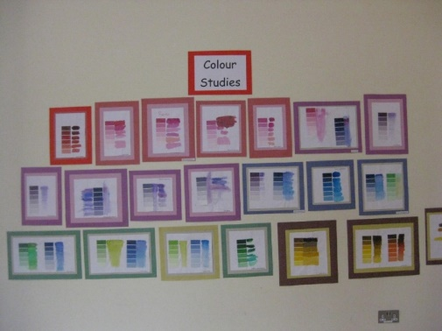
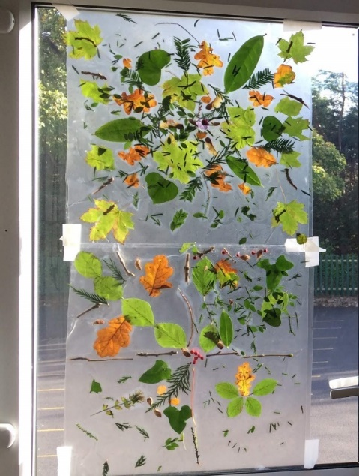
Making Art
Drawing
Using a viewfinder against a landscape, draw what is visible through the viewfinder.
Paint and Colour
Create a colour study inspired by the colour green. Using colour cards (available in home stores), the children experiment with colour mixing and try to achieve each tone of green on the colour card.
Children collect a selection of leaves and foliage and again observe tones visible on the leaves and match these up to a selection of colour cards (green/browns/reds/oranges)
Paint a landscape to explore atmospheric perspective - trees become lighter in the distance. This could also be explored by using tissue papers (tearing/overlapping).
Print
Children collect objects from nature and create a print block or collograph. Apply printing ink to this with a roller and explore making prints onto various papers.
Fossils - using a slab of clay, children could imprint interesting objects they find in nature to create interesting prints. (leaves/twigs/shells/seeds)
Construction
Create a 'land art' installation. Children collect objects from nature and arrange them into a composition. Work could be photographed for assessment purposes as it is a temporary
work or this project could be applied onto
contact paper as a way to preserve.

Slide 19
Integration
SPHE (Social, Personal and Health Education)
Strand: Myself.
Strand unit: Self-identity.
Focus on wellbeing and developing resilience through mindful practice.
Geography
Strand: Natural Environments.
Strand unit: The local natural environment.
Looking at the natural features in this painting and locating the subject on a map. Investigating the species of flora and fauna.
Physical Education
Strand: Gymnastics.
Strand unit: Movement.
Exploring balance and movement using your body.
Music
Strand: Listening and Responding.
Strand unit: exploring sounds
Strand: Composing.
Strand unit: Improvising and creating.
Using the senses to appreciate sounds. Composing a story through music inspired by the artwork. Record sounds you hear during a nature walk in your locality. Identify birds by their song.
Drama
Strand: Drama to explore feelings, knowledge and ideas, leading to understanding.
Strand Unit: Exploring and making drama.
Working together in small groups to
create and perform a yoga story
inspired by the artwork.

Slide 20
Contact us
Sign up to the Teachers & Schools email newsletter to be regularly updated with new ideas and resources.
Catherine O’Donnell
Education Officer
With responsibility for Teachers, Schools & Youth
T: +353 (0) 1 663 3579
E: codonnell@ngi.ie

